Slide 1
Power Electronics For The Geec
Conor Farrell 2025-2026
MECE - 21359763

Slide 2

Project Overview
The GEEC (Galway Energy Efficient Car) is a participant in the Shell Eco Marathon.
It’s entered in the prototype lithium-ion class.
The highest score GEEC achieved was 354km/kWh or 23c to drive from here to Dublin.
Power Electronics Requirements:
Drive an Electric Motor.
Take Throttle input from the driver
Fail Safe
Notes:
BG
GEEC – SEM prototype lithium ion
DAQ – voltage current power speed temp gps
Driver display
Benefit to mechanicals

Slide 3
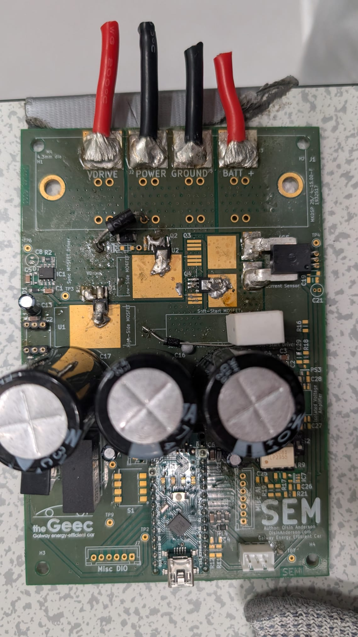
Current Power Electronics
Inflexible
Obsolete Components
2 Layer Design
Large Loop Area, resulting in LC resonator
Field Modifications

Slide 4
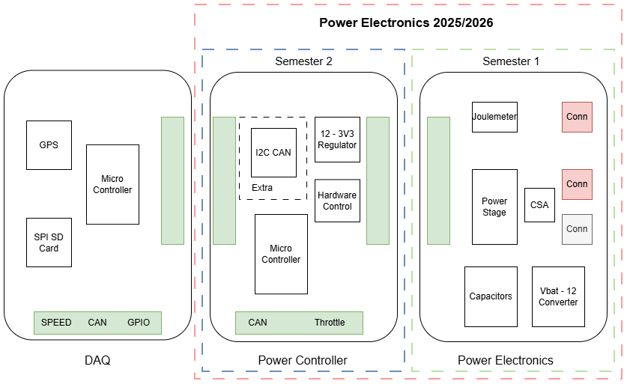
The Project Scope
Semester 1: Power Electronics
4 layer SMD
Full isolation
Semester 2:
Power Controller
2 layer THT
Closed Loop Feedback

Slide 5
Brushless Motors
Previous Projects Investigated Brushless Controllers & 48V control
Theoretical Calculations show worse performance ~2%

Slide 6
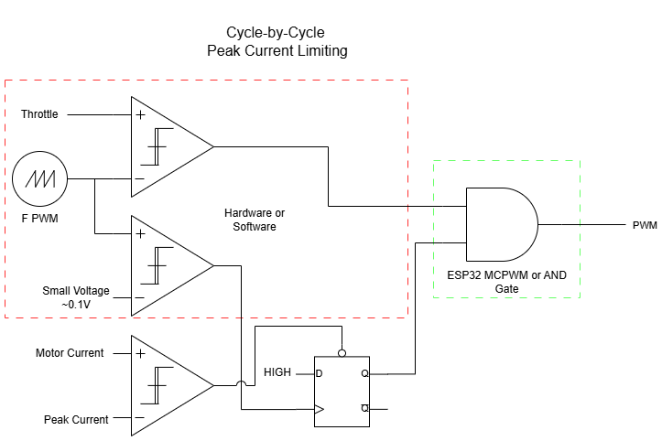
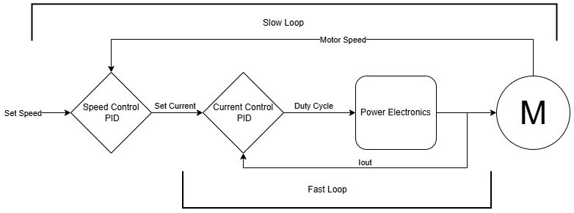
Current Control
Hardware Limiting:
Cycle-by-Cycle (10-30kHz)
Latching
Software Control:
~10Hz
PID loop

Slide 7
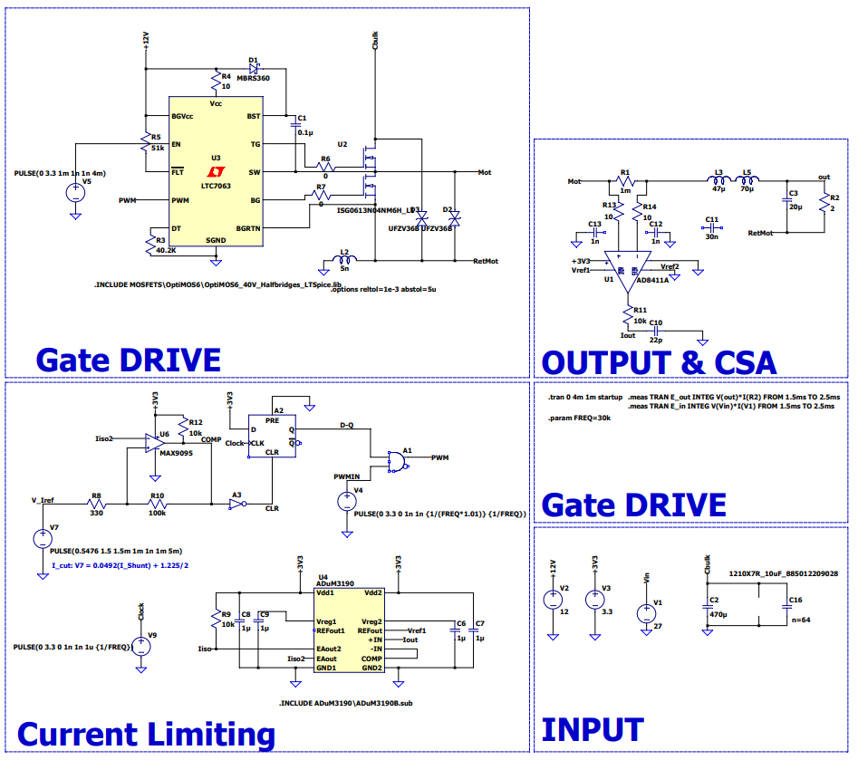
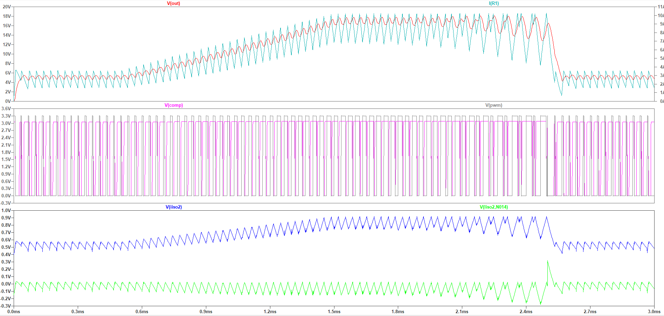
Simulation
Closed Loop Current Control
Variable Current Limit

Slide 8
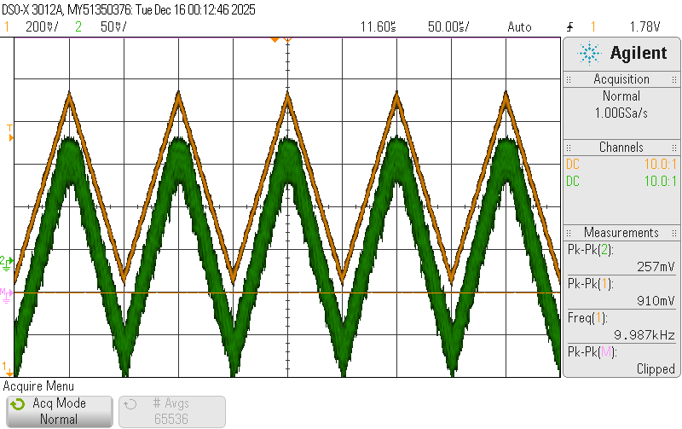
Testing
Orange: AD8411A
Green: ADuM3190 Expected A_{V}: 1 Actual A_{V}: 0.33
Solution: Op-Amp (A_{V} 2) and 800kHz low pass filter on Power Controller.

Slide 9
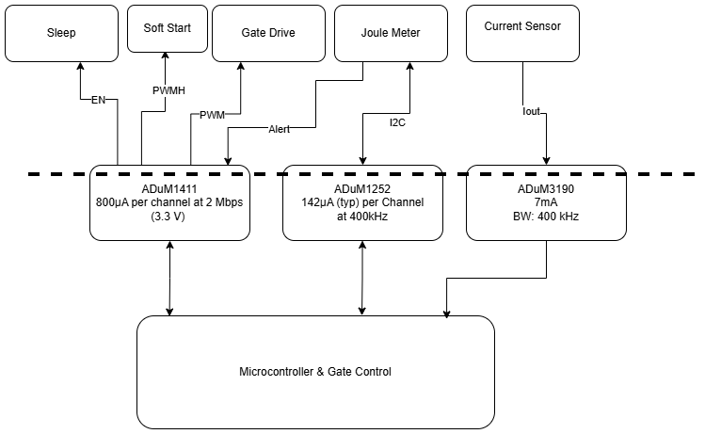
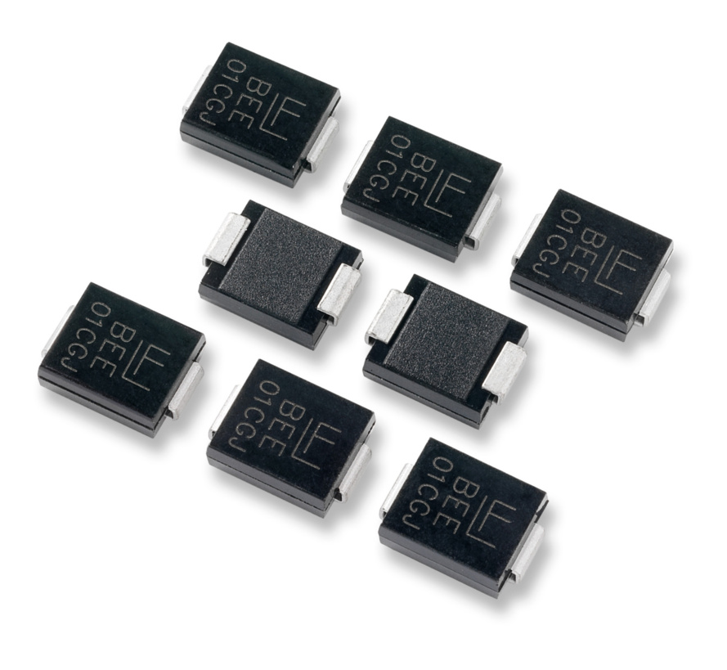
Protection
Low power digital and analogue isolators.
Consumes 46mW
TVS Diodes to shunt 15A at 38V

Slide 10
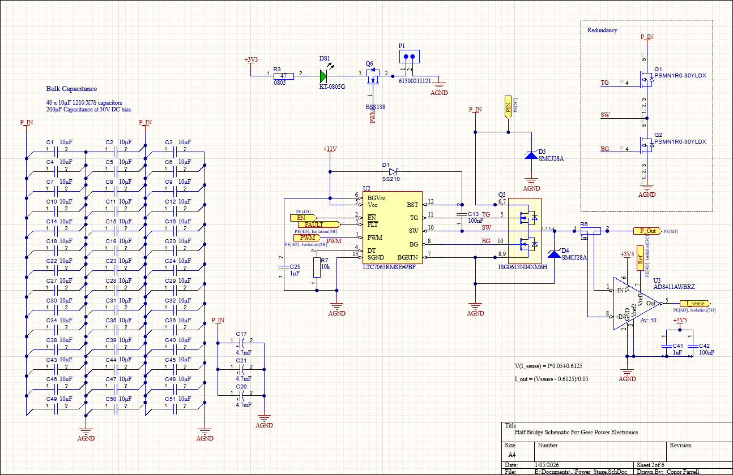
Schematic
Half Bridge Design
40 10µF MLCC Capacitors & 3 4.7mF Electrolytic Capacitors
Redundant MOSFETS for easy Replacement
TVS Diodes Capable of shunting 15A @ 38V
Indicator LED with removable jumper.

Slide 11
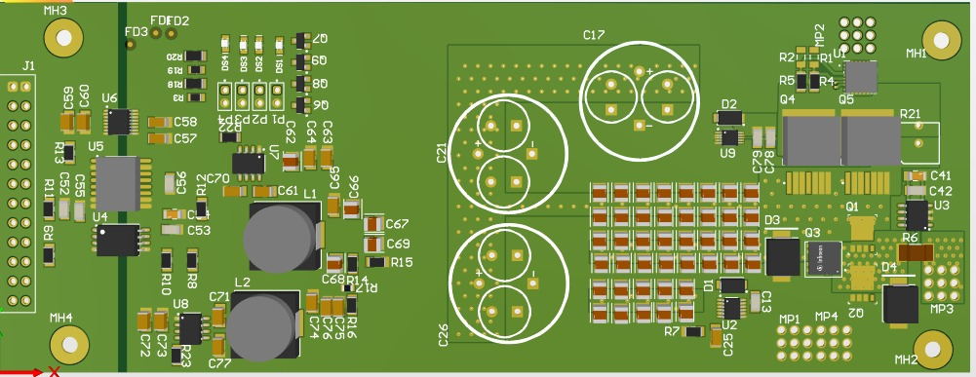
PCB Design
4 Layer Board, Isolated Ground planes
Via Stitching on High current planes
Minimisation of loop area and change in loop area
Preliminary Design

Slide 12

This Semester
Design Power Controller Board
Assist in Design of DAQ Board
Testing of Hardware
Implement Control System
Integrate the Design into the DAQ
Determine Performance Improvement

Slide 13
Thanks For Listening
Any Questions?

